Slide 1
PROGRAMMING SKILL CHECKER
RETAJ ALLUHAIBI 4410459
Zayneb Salim mchich 4510734
Hayat Flath 4412156
Jory Aloufi 4412261
Rama Alahmadi 4510153

Slide 2

Introduction
The Programming Skill Checker helps learners and job seekers focus on the most in-demand technical skills by identifying key priorities, ensuring they stay competitive and fully maximize their potential in the field.

Slide 3
Project Objectives
Skill Verification
Ease of Use
Customization
Provide a simple interface for checking.
Develop a user-friendly tool using Python and Tkinter .
Allow the skill list to be easily updated to reflect industry trends.

Slide 4
Project Description
Users input a programming skill in a text box.
The program compares the input against a predefined list of required skills.
A message box displays whether the skill is in demand or not.
01
The Programming Skill Checker operates as follows:
02
Key Features:
Customizable skill list.
Interactive graphical user interface.
Immediate feedback to the user.
03
Skills Supported (initial list):
Python, Java, HTML, CSS, JavaScript, SQL, Git, React.js.

Slide 5

Code Overview
The program is developed in Python and employs the Tkinter library for its GUI. Below are key snippets:
Skill Verification Function:
User Interface Setup:
def check_skills():
skill = skill_entry.get().lower()
if skill in ['python', 'java', 'html', 'css', 'javascript', 'sql']:
messagebox.showinfo("Result", f"{skill.capitalize()} is a required skill!")
else:
messagebox.showwarning("Result", f"{skill.capitalize()} is not listed as a required skill.")
app = tk.Tk()
app.title("Skill Checker")
tk.Label(app, text="Enter the programming skill:").pack(pady=5)
skill_entry = tk.Entry(app, width=30)
skill_entry.pack(pady=5)
check_button = tk.Button(app, text="Check Skill", command=check_skills)
check_button.pack(pady=10)
app.mainloop()

Slide 6
Results
The tool successfully identifies required and non-required skills based on the predefined list. Below are sample outcomes:
1. Input: Python → Output: “Python is a required skill!”
2. Input: Ruby → Output: “Ruby is not listed as a required skill.”
Pattern Recognition
Statistical Modeling

Slide 7
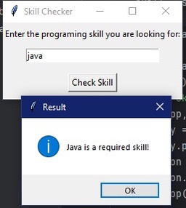
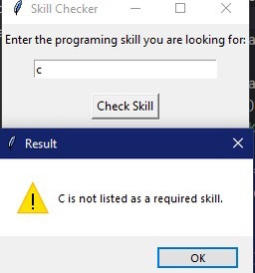
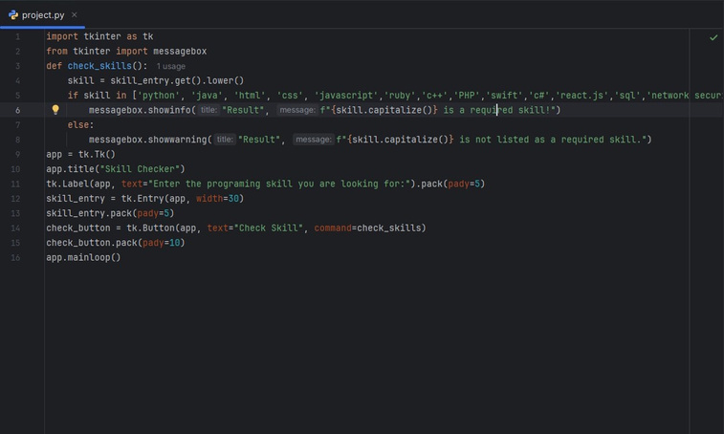
Program in Action
screenshots of the program
Input of a required skill and displaying “Skill is required.”
Input of a skill not listed and displaying “Skill is not required.”

Slide 8
Algorithm
1. Start
• Open the GUl window.
2. Input
• User enters a skill in the text field.
3. Process
* The program fetches the input and converts it to lowercase.
* Checks if the skill exists in the predefined list.
4. Output
* Show a success message if the skill is found.
* Show a warning message if the skill is not found.
5. Repeat
• Wait for the next input or close the application.
Threat Identification
Automated Actions

Slide 9
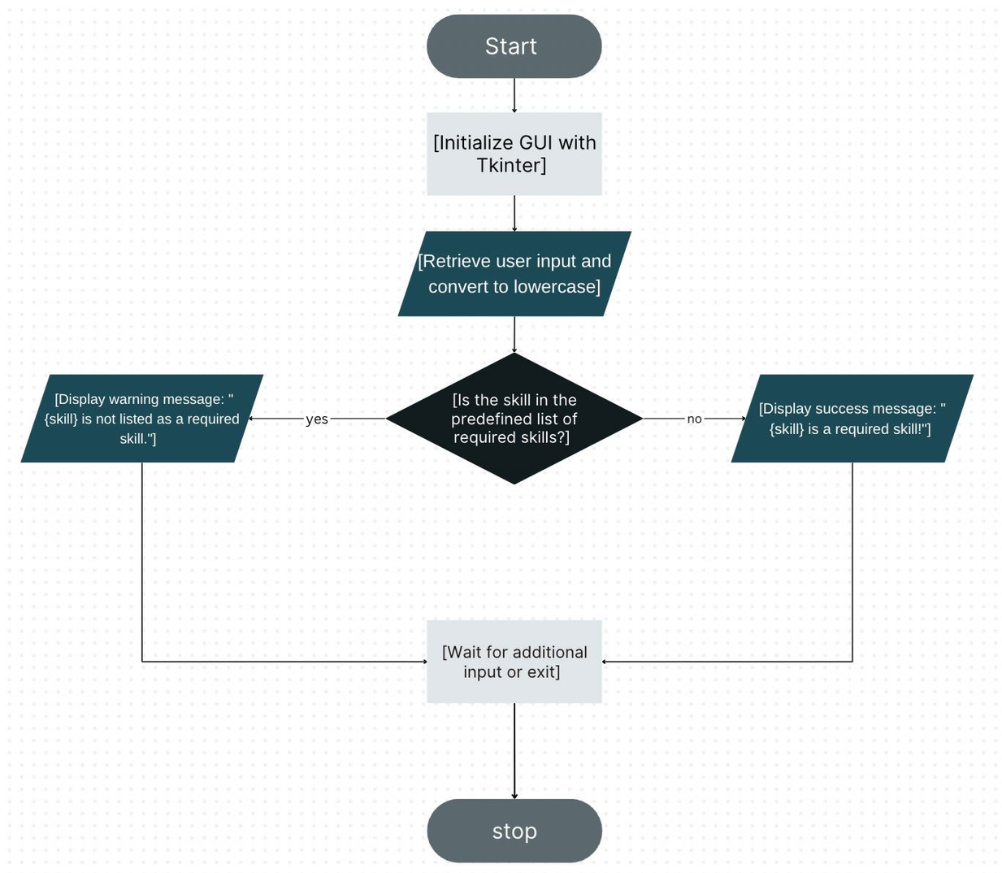

Slide 10
References
1
Python Documentation: https://docs.python.org
2
Tkinter GUI Programming: Tkinter Documentation
3
Programming Skills in Demand: [Insert Resource]

Slide 11

Abstract
This report presents the Programming Skill Checker, a Python-based tool using Tkinter that helps users verify the demand for specific programming skills. It provides immediate feedback, making it valuable for learners and job seekers in the tech industry.

Slide 12

Conclusion
The Programming Skill Checker is a valuable tool for learners and job seekers, offering a simple interface and customizable features. Future improvements could include dynamic updates and integration with job market data.

Slide 13
This report presents the Programming Skill Checker, a Python-based tool using Tkinter that helps users verify the demand for specific programming skills. It provides immediate feedback, making it valuable for learners and job seekers in the tech industry.
Thank you
Threat Identification
Automated Actions

